Slide 1
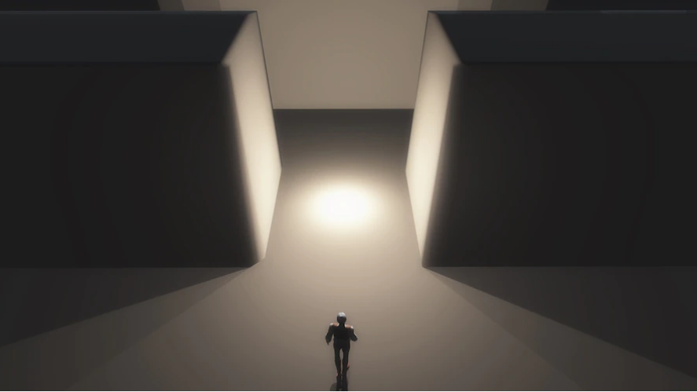
A* LABORATORY PROJECT
Antonio Trujillo
Alberto Trigueros
Jesús Fuentes
María Peinado
Group C

Slide 2

INDEX
1. Introduction
2. Structure of the application, design choices
3. Experimental results, performance slots, coments.

Slide 3

INTRODUCTION
This project is focused on creating a function with the ability of solving a maze. The algorithm should create a path from the initial point to the end, avoiding obstacles and staying into the maze. Furthermore, it should alert if the initial and end point are in the same place or if one of these points match with an obstacle. In the following slides, we are going to explain how we got that.

Slide 4
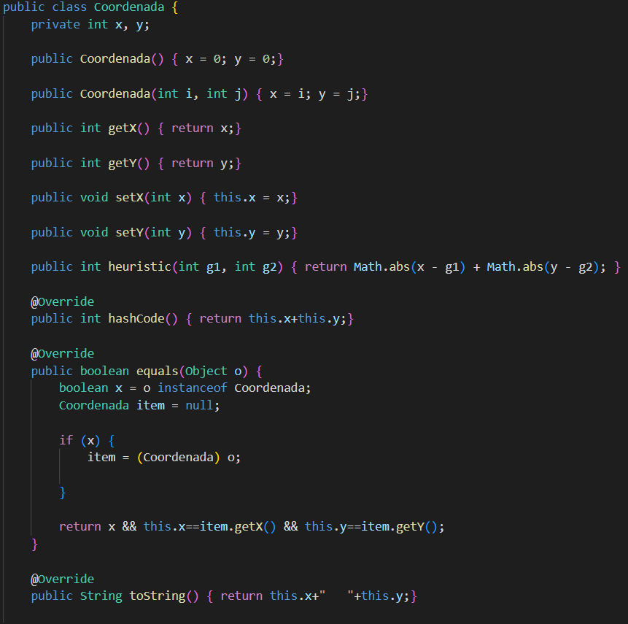
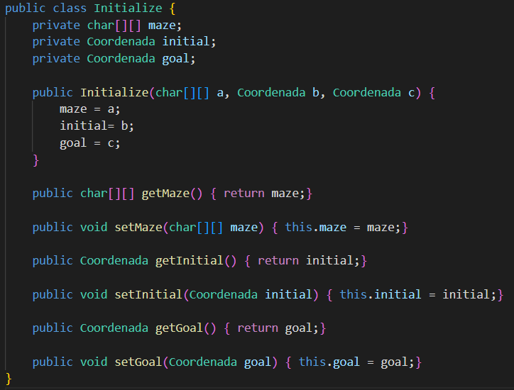

Structure of the application, design choices
Class Coordenada
Class initialize
To initialize we need a maze, the initial coordinate and the goal coordinate
The heuristic formula
$h=|x−g_{1}|+|y−g_{2}|$
We consider that two Coordinates are the same if their x and y are equal.

Slide 5
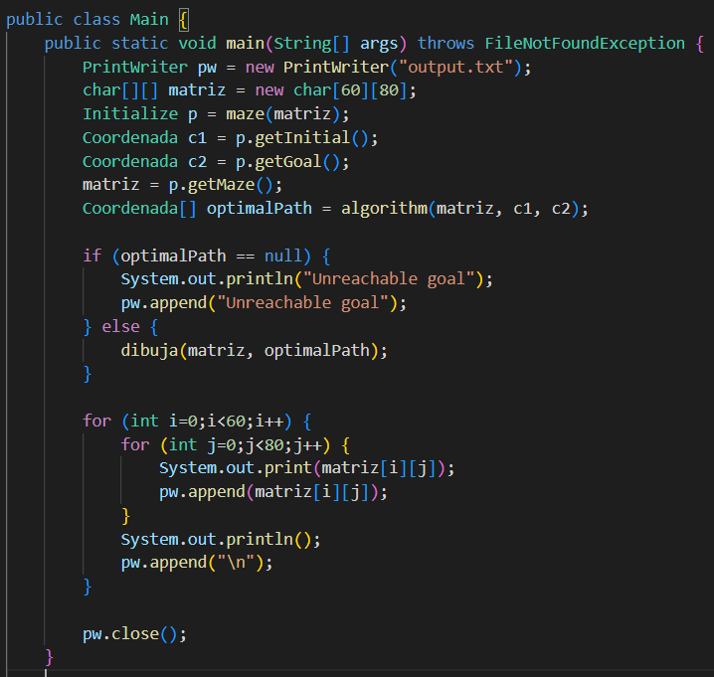
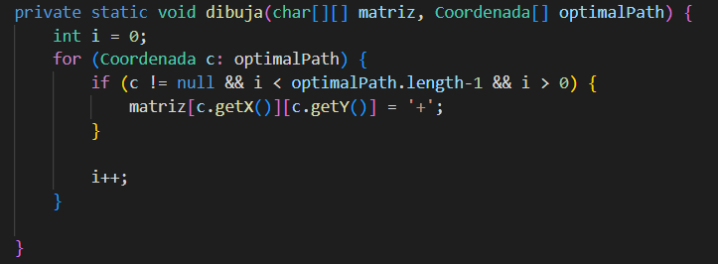
Structure of the application, design choices
Class main
We create an empty maze 60x80 and we initialize by using the function maze.

Slide 6
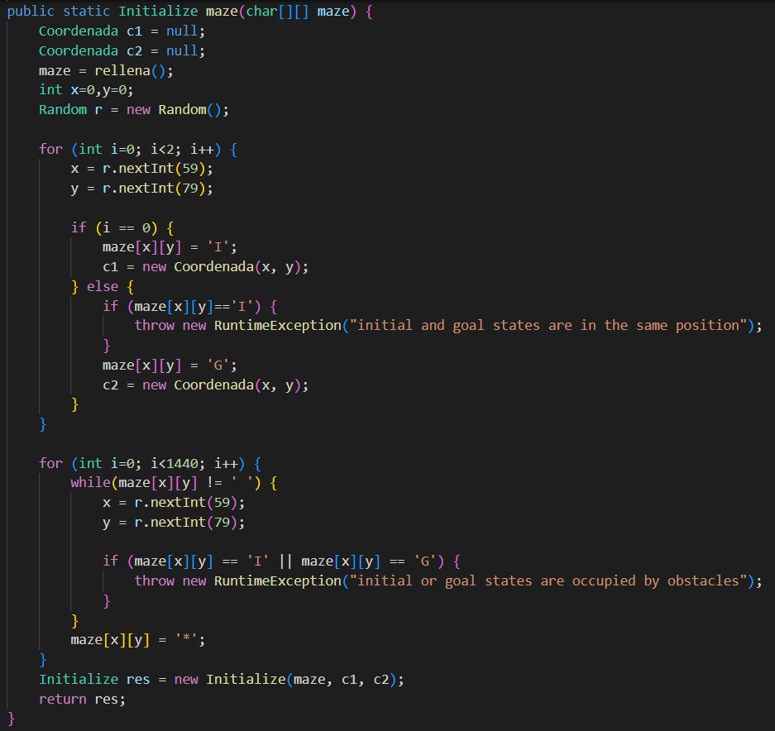
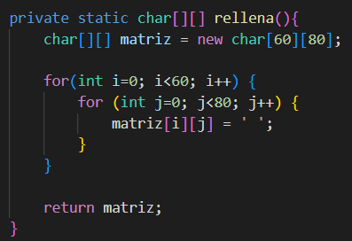
Structure of the application, design choices
We fill the matrix with empty space.
We locate the initial and the goal coordinate by using the class random and making sure that they are different.
We fill the 1/3 of the maze of obstacles (taking care of not putting one of them in the initial or the goal coordinate).

Slide 7
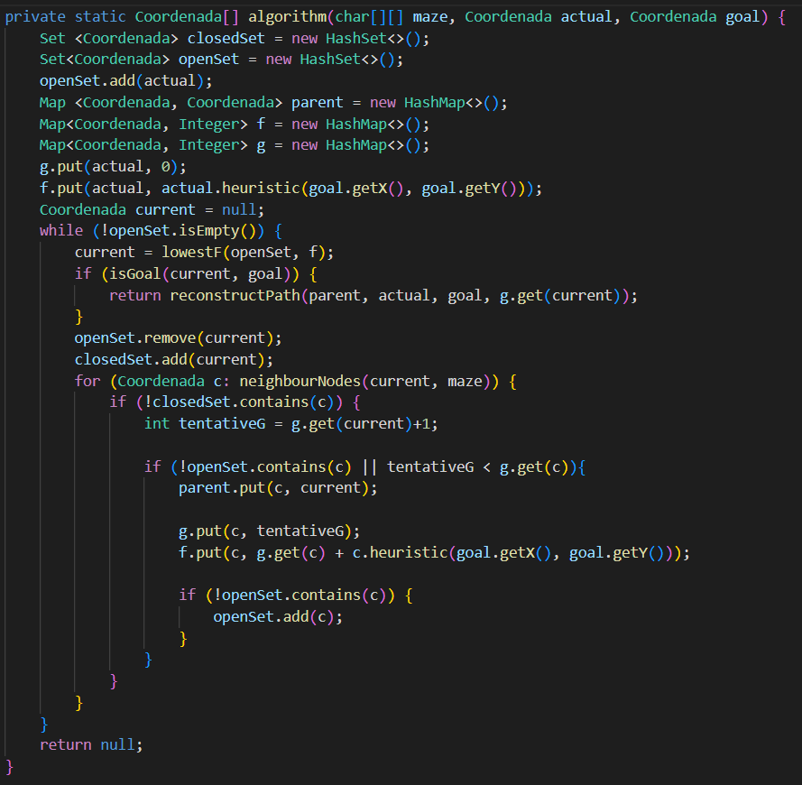
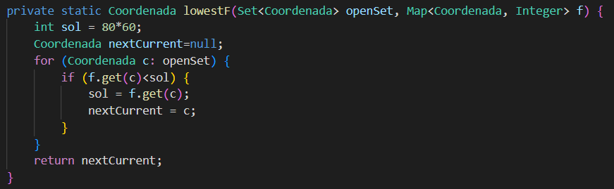
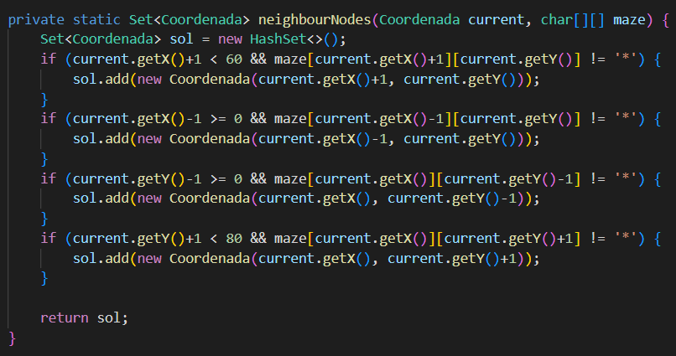
Structure of the application, design choices
We create the closedSet and the openSet. We add to the openSet the initial.
We initialize sol to a maximum value
We use Map for the path, for f and for g.
In g we add the initial and the value 0.
In f we add the initial with the heuristic.
We look inside of the openSet the one with lowestF and we store in the variable nextCurrent.
While the openSet is empty we are searching the lowesF, if we obtain the goal we return the path.
We remove from the openSet the node we are studying and we added to the closed set.
We study all de neighbourNodes that are still in the openSet or even not in there, changing it g if is necessary and including it f in the Map, and finally adding to the openset if they were not there.
We look up, down, right and left maze squares, making sure that they are posible nodes (inside of the maze and not obstacle).

Slide 8
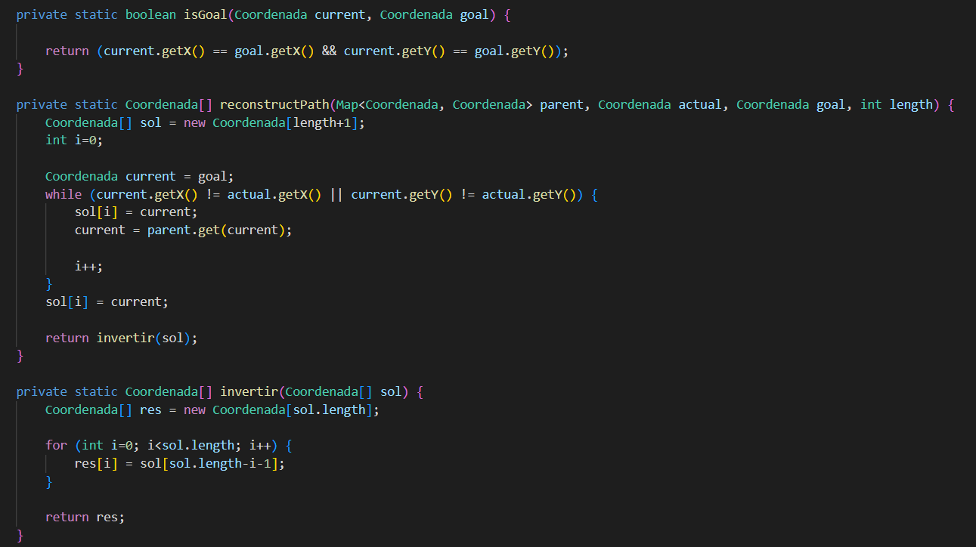
Structure of the application, design choices
Return if the current coordinate is the same as the goal one
The path solution is an array of coordinates.
We are adding from the goal to the initial node by using the Map parent. And finally we invert the array just built.
Function to invert an array

Slide 9
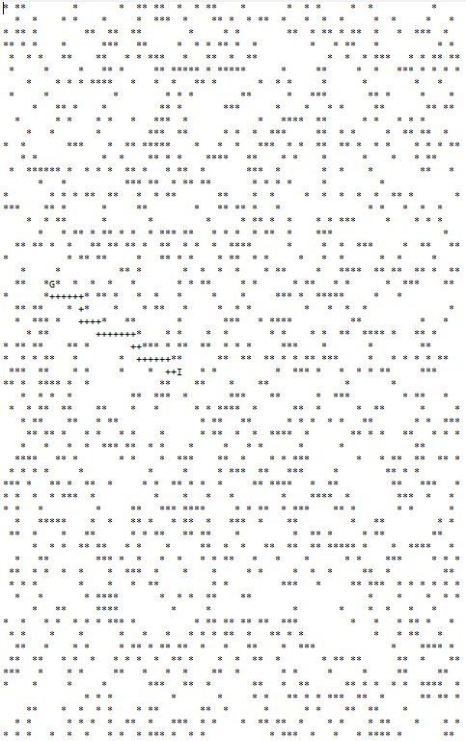
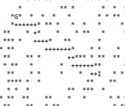
Experimental results, performance slots, coments
In the picture we can see a maze where each blank cell is a valid position. Meanwhile, each asterisk represents an obstacle, which means that our algorithm can’t use that cell to continue and has to choose another way. As it is shown, the algorithm starts on I (Initial) and looks for a path (represented with the symbol “+”) to get to G (Goal) avoiding the obstacles.
Always looking for the most optimistic path

